Slide 1

SERVERFLOW
Intelligent request routing using Greedy and Priority Queue algorithms.
Team
Institution
Domain
Poluru Niklesh
Kammari Vinay Kumar
Gojur Ravi Teja
Avula Gouri Shankar
Malla Reddy Technical Campus
Distributed Systems / Web Infrastructure / Algorithm Optimization
Core Routing Principle
An incoming request is routed to the most suitable server using queue length, capacity, and estimated response cost.
Notes:
1

Slide 2
SYSTEM BOTTLENECKS
The challenge: avoiding server overload
What matters in distributed routing
Continuous Influx
Requests arrive continuously while servers carry different workloads and capacities.
Fast selection
Capacity awareness
Hidden Bottlenecks
A short queue can still hide a capacity bottleneck.
Cascading Delays
Predictable handling
Balanced utilization
A poor routing choice increases waiting time and queue buildup.
Notes:
2

Slide 3
ROUTING ARCHITECTURE
Our innovation: score every feasible server
For each incoming request, evaluate the live server state and make the best feasible local choice.
Priority Queue
Greedy selection
Configurable score
Keeps candidate servers ordered by routing priority dynamically.
Chooses the strongest available candidate node immediately.
Evaluates queue load + response cost + capacity penalty.
Traditional Load Balancing
Fixed round-robin or random server routing ignores
Notes:
3

Slide 4
END-TO-END EXECUTION
System workflow: from request to response
4. Greedy selection
3. Priority Queue ranking
Greedy strategy selects the best feasible server.
2. Telemetry read
Priority Queue ranks the available server candidates.
1. Client request
Router reads queue length, capacity, and estimated response cost.
Client sends a request to the router.
6. Statistics update
5. Assignment
Queue and load statistics update for the next decision.
Request is assigned and processed.
Decision example: R104
R104 favors a low-cost, low-queue server with enough capacity.
Notes:
4

Slide 5
TECH STACK & COMPLEXITY
Technology and algorithm engine
Implementation Stack
Algorithmic Complexity
Greedy Strategy
Priority Queue Heap
Fast local choice for each incoming request without global backtracking overhead.
Efficient candidate management as priorities change dynamically.
Frontend
Backend
HTML, CSS, JavaScript dashboard and live visualization.
Python + Flask request-routing simulator engine.
Complexity Target
Insert / update runs in O(log n); best-candidate retrieval takes O(1) peek or O(log n) removal.
Data Layer
In-memory server and request state for prototype speed.
Notes:
5

Slide 6
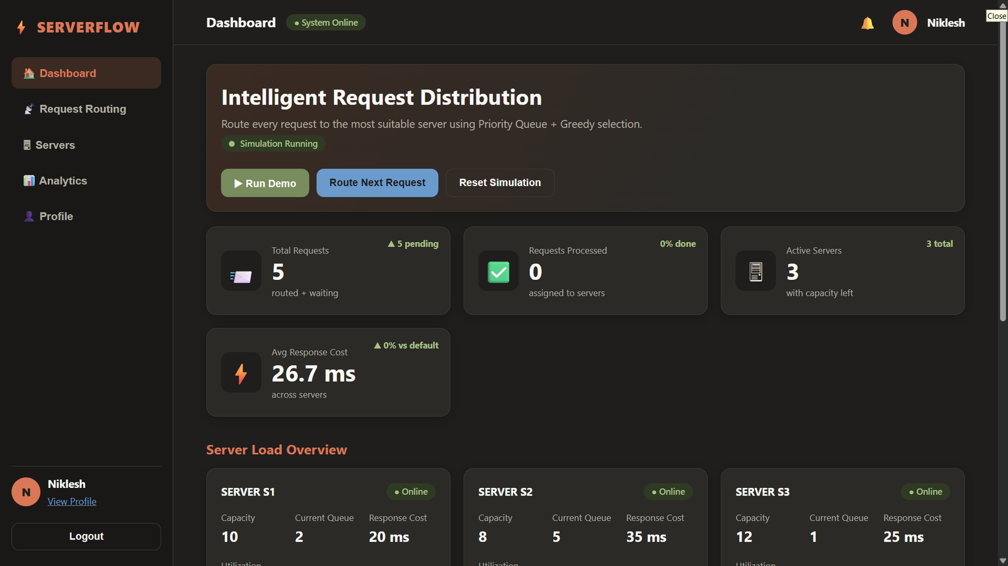
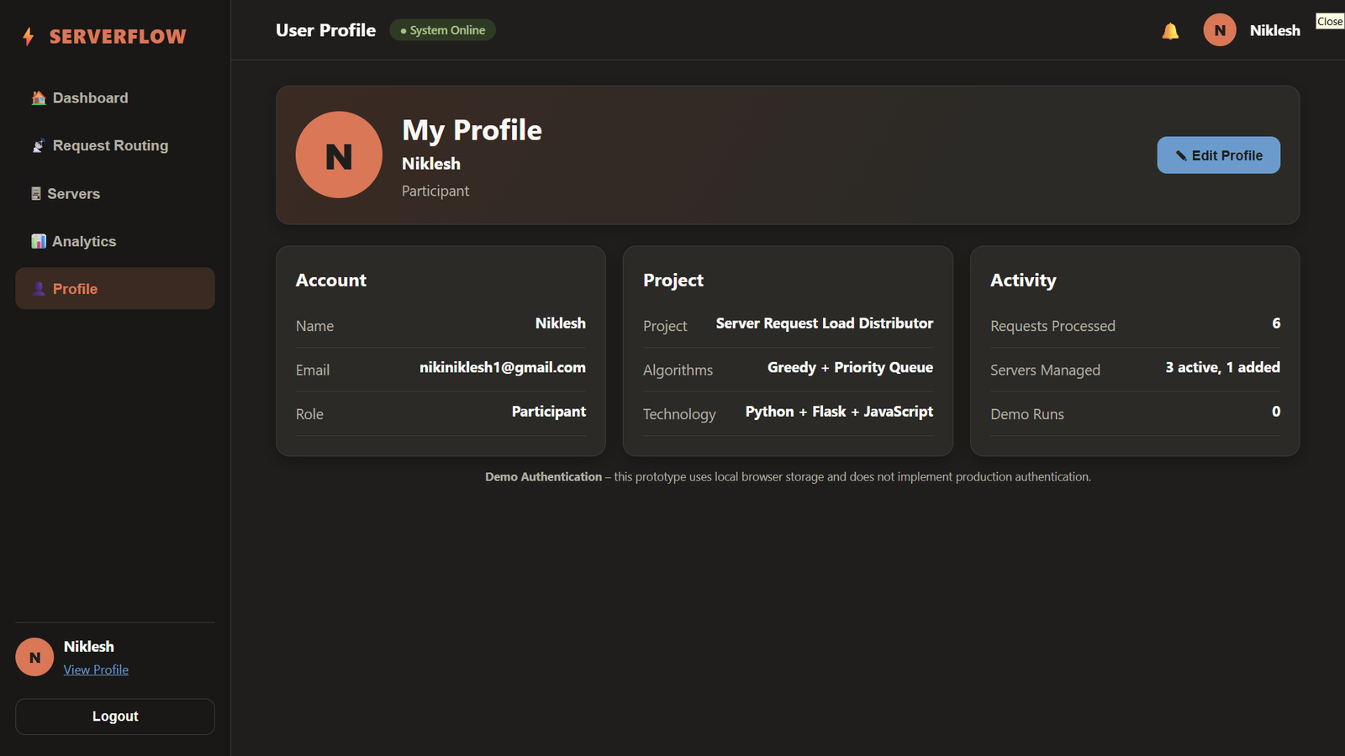
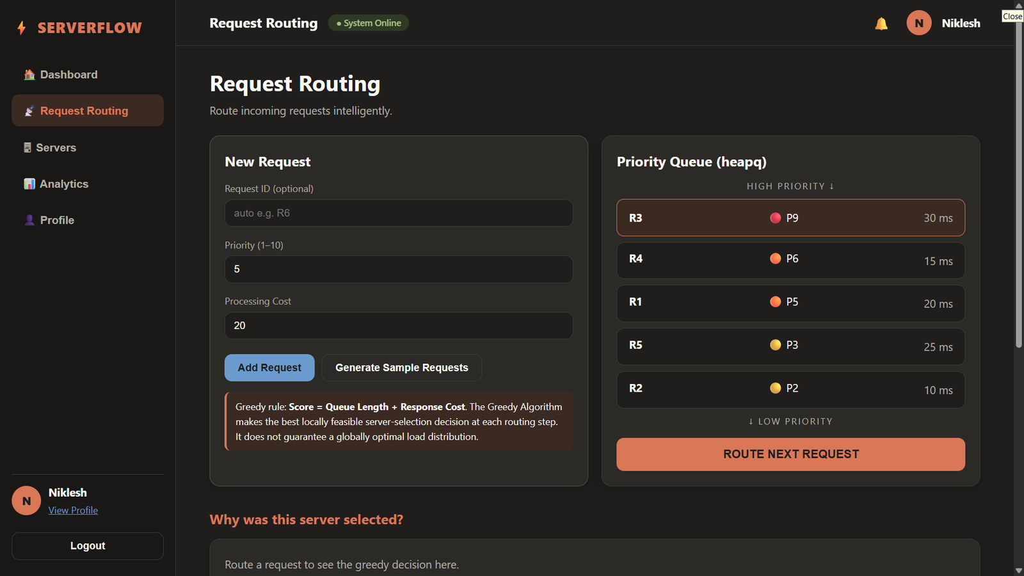
Dashboard
User Profile
Request Routing
Live overview of requests, active servers and average response cost, with Run Demo, Route Next Request and Reset controls.
Participant profile showing the project, the Greedy + Priority Queue algorithms, the Python + Flask + JavaScript stack and activity counts.
Requests wait in a priority queue (heapq), highest priority first. Each is routed by Score = Queue Length + Response Cost.
The Priority Queue orders requests, Greedy selection picks the best server, and the dashboard shows every decision live.
Notes:
6

Slide 7
ROADMAP & SUMMARY
Future vision: from simulation to platform
Route smarter. Balance workloads. Respond faster.
THANK YOU · Q&A
Notes:
7

